Slide 1

State of VI Health Information and Data on Public Health
Esther M. Ellis, PhD
Territorial Epidemiologist
USVI Department of Health

Slide 2
What is Public Health Surveillance?
Ongoing, systematic collection, analysis, and interpretation of health-related data and dissemination for use in the planning, implementation, and evaluation of public health practice

Slide 3
National Notifiable Disease Surveillance
Regular, frequent, timely information to prevent and control disease
Reporting mandated by state/territory law
  regulation in conjunction with CDC
Health care providers and laboratories report to local county health department (HD)
County HD submits reports to State
Reports transmitted to CDC through National Electronic Disease Surveillance System (NEDSS)

Slide 4
Why do Surveillance?
Collect data to better understand the extent of health risk behaviors, preventive care practices and the burden of chronic diseases
Monitor the progress of prevention efforts
Help public health professionals and policymakers make more timely and effective decisions

Slide 5
Uses of Public Health Surveillance
Estimate magnitude of the problem
Portray the natural history of a disease
Determine distribution and spread of illness
Detect outbreaks
Generate hypotheses, stimulate research
Evaluate control and prevention measures
Monitor changes in infectious agents
Detect changes in health practices
Facilitate planning

Slide 6
Causal Pathway of Disease or Disability
Environment (pre-exposure)
Hazard/agent
Behavior risk factor
Exposure
Pre-symptomatic phase
Apparent disease
Death

Slide 7
Selected Sources of Data
Environment monitoring systems
Animals/vectors
Individuals
Laboratories
Medical records
Administrative records
Police records
Birth/death certificates

Slide 8
Data Sources and Methods for Surveillance
Notifiable diseases
Laboratory specimens
Vital records
Sentinel surveillance
Registries
Surveys
Administrative data systems
Other data sources
Notes:
Vital records – National infant mortality surveillance, vital records can be linked to birth records
Sentinel – Monitoring of key health events through sentinel sites, events, providers vectors or animals
Surveys – populations-based surveys such as the National health Interview Survey or provider-based surveys such as a hospital discharge survey
Other data sources – Vaccine adverse event reporting system, the CDC drug service or others

Slide 9
CONDITION_NAME
Anthrax
Arboviral diseases, neuroinvasive and non-neuroinvasive:
California serogroup virus disease, neuroinvasive
California serogroup virus disease, non-neuroinvasive
Chikungunya neuroinvasive disease
Chikungunya non-neuroinvasive disease
Eastern equine encephalitis virus disease, neuroinvasive
Eastern equine encephalitis virus disease, non-neuroinvasive
Powassan virus disease, neuroinvasive
Powassan virus disease, non-neuroinvasive
St. Louis encephalitis virus disease, neuroinvasive
St. Louis encephalitis virus disease, non-neuroinvasive
West Nile virus disease, neuroinvasive
West Nile virus disease, non-neuroinvasive
Western equine encephalitis virus disease, neuroinvasive
Western equine encephalitis virus disease, non-neuroinvasive
Babesiosis
Botulism:
foodborne
infant
other (wound and unspecified)
Brucellosis
Campylobacteriosis
Chancroid
Chlamydia trachomatis infection
Cholera
Coccidioidomycosis
Cryptosporidiosis
Cyclosporiasis
Dengue:
Dengue
Dengue-like illness
Dengue, severe
Diphtheria
Ehrlichiosis/Anaplasmosis:
Ehrichia chaffeensis
Ehrlichia ewingii
Anaplasma phagocytophilum
Undetermined
Giardiasis
Gonorrhea
Haemophilus influenzae, invasive disease
Hansen disease (leprosy)
Hantavirus infections:
Hantavirus infection (non-HPS)
Hantavirus pulmonary syndrome (HPS)
Hemolytic uremic syndrome, post-diarrheal
Hepatitis:
Hepatitis A, acute
Hepatitis B, acute
Hepatitis B, chronic
Hepatitis B, perinatal infection
Hepatitis C, acute
Hepatitis C, past or present
Influenza-associated pediatric mortality
Invasive Pneumococcal Disease
Legionellosis
Leptospirosis
Listeriosis
Lyme disease
Malaria
Measles
Meningococcal disease
Mumps
Novel influenza A virus infections
Pertussis
Plague
Poliomyelitis, paralytic
Poliovirus infection, nonparalytic
Psittacosis
Q fever:
Acute
Chronic
Rabies:
Rabies, animal
Rabies, human
Rubella
Rubella, congenital syndrome
Salmonellosis
Severe Acute Respiratory Syndrome-associated Coronavirus (SARS-CoV) disease
Shiga toxin-producing Escherichia coli
Shigellosis
Smallpox
Spotted Fever Rickettsiosis
Streptococcal toxic-shock syndrome
Syphilis:
primary
secondary
early latent
late latent
latent unknown duration
Neurosyphilis
late, non-neurological
congenital
Tetanus
Toxic shock syndrome (other than Streptococcal)
Trichinellosis
Tuberculosis
Tularemia
Typhoid fever
Vancomycin - intermediate Staphylococcus aureus (VISA)
Vancomycin-resistant Staphylococcus aureus (VRSA)
Varicella (morbidity)
Varicella deaths
Vibriosis
Viral Hemorrhagic Fevers:
Ebola hemorrhagic fever
Marbug fever
Crimean-congo hemorrhagic fever
Lassa fever
Junin (Argentine) hemorrhagic fever
Machupo (Bolivian) hemorrhagic fever
Sabia-associated (Braziliam) hemorrhagic fever
Lujo Virus (organism)
Guanarito hemorrhagic fever
Yellow fever

Slide 10
Reportable Diseases
National Electronic Disease Surveillance System (NEDSS)
  Efficient, interoperable, and integrated surveillance system that facilitates the electronic transfer of appropriate information from clinical information systems in the Healthcare industry to public health departments
  A set of criteria developed by CDC that all public health surveillance systems must meet
  Used to manage reportable disease surveillance data
  Supported by CDC funds
December 18, 2014 USVI went live with NEDSS
  This system now allows us to conduct more accurate surveillance and analysis of notifiable diseases for our territory

Slide 11
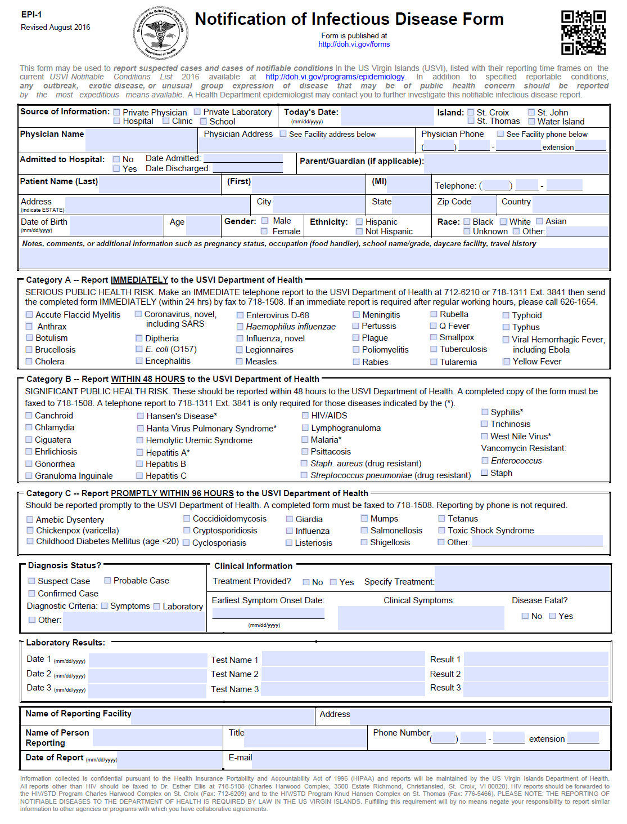

Slide 17
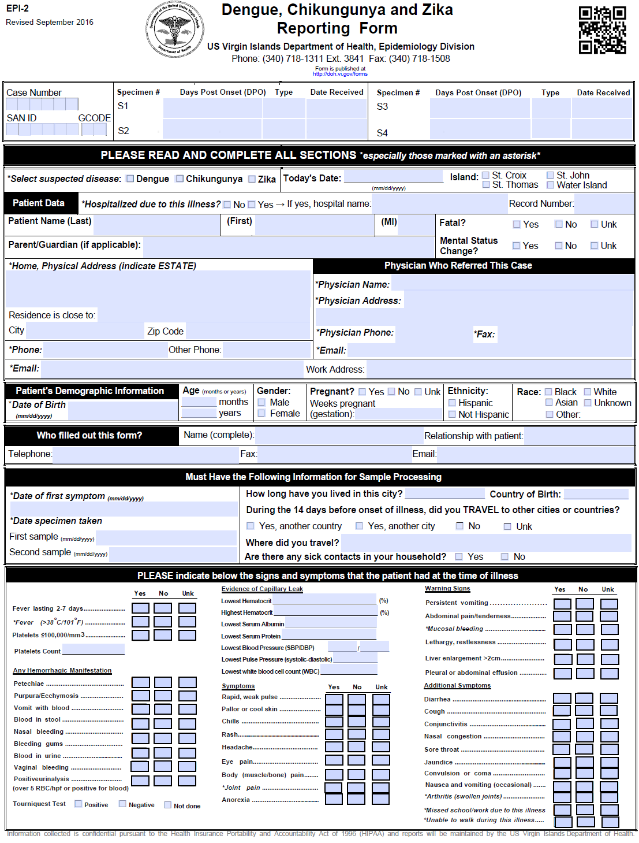

Slide 18
Types of Surveillance in USVI
Reportable diseases
Vital Statistics
Survey Data
  BRFSS
National Registries
  Cancer registry
Others
  Performance Management and Quality Improvement (PMQI), chart reviews, insurance data
Notes:
By improving both performance and quality, public health systems save lives, cut costs and get better results.

Slide 19
BRFSS
The Behavioral Risk Factor Surveillance System (BRFSS) is the world’s largest, on-going telephone health survey system.
  Random digit telephone surveys on non-institutionalized adults’ health behavior and use of prevention services
  Height, weight, physical activity, smoking, alcohol use, seatbelt use, cholesterol screening, mammography, etc.
  Done in most states and territories
  CDC program

Slide 20
BRFSS
Cardiovascular Questions
  Have you ever been told by a doctor, nurse, or health professional that you have high blood pressure?
  Had cholesterol checked and told high by doctor, nurse, or other health professional?
  Has a doctor, nurse, or other health professional ever told you that you had any of the following? A heart attack, also called a myocardial infarction?
  Has a doctor, nurse or other health professional ever told you that you had any of the following…Angina or coronary heart disease
Underlying risk factors
  Physical activities, nutrition, smoking, diabetes, etc.

Slide 21
Steps of an Outbreak Investigation
Establish the existence of an outbreak or new disease
Verify the diagnosis
Define and identify cases
Describe and orient the data: time, place, and person
Develop hypotheses
Evaluate hypotheses
Refine hypotheses and carry out additional studies
Implement control and prevention measures
Communicate findings

Slide 22
Risk of Emerging Disease
Highly resistant pathogens in health-care settings
  Multi drug resistant (MDR) Salmonella
  MDR and Extensive Drug Resistance (XDR) TB
  MDR Pseudomonas
  MRSA
  Clostridium difficile
  Drug resistant N. gonorrhea
  Carbapenem resistant enterobacteria (CRE)
    E. coli
    Kleibsiella
  One in 20 hospitalized patients in the United States is infected during their health care.
Killer microbes that jump from animals to humans
New deadly pathogens
Viruses that have not previously occurred here, brought in by travelers (Chikungunya, Zika)
Notes:
http://www.cdc.gov/drugresistance/threat-report-2013/pdf/FY15-DPAR-budget-init.pdf

Slide 23
Establish the Outbreak
Are there more cases than would be expected?
What is the incidence:
  in the area
  at this time
  in this season
  with these people
  with these animals/ insects/ vectors

Slide 24
Outbreak Decision: Consult Data Sources and Methods for Surveillance
Notifiable diseases: CDC, County Health Department
Laboratory specimens
Vital records
Sentinel surveillance (death)
Registries
Surveys
Administrative data systems
Vaccine Adverse Event Reporting System
Other data sources

Slide 25
Causes of Perceived Outbreaks
Increased population in area
New personnel
New lab tests
New reporting criteria/ case definition

Slide 26
Steps of an Outbreak Investigation
Establish the existence of an outbreak
Verify the diagnosis
Define and identify cases
Describe and orient the data in terms of time, place, and person
Develop hypotheses
Evaluate hypotheses
Refine hypotheses and carry out additional studies
Implement control and prevention measures
Communicate findings

Slide 27
Define and Identify Cases: Case Definitions
  Non infectious
    Cancer and toxins in water
  Infectious
    Confirmed: lab verification
      PulseNet (gel electrophoresis DNA “fingerprint”)
      Culture, PCR, IFA, IgM, IgG
    Suspected: typical presentation without lab confirmation
    Possible: fewer symptoms than typical case
“Get It While You Can.”

Slide 28
Steps of an Outbreak Investigation
Prepare for field work
Establish the existence of an outbreak
Verify the diagnosis
Define and identify cases
Describe and orient the data in terms of time, place, and person
Develop hypotheses
Evaluate hypotheses
Refine hypotheses and carry out additional studies
Implement control and prevention measures
Communicate findings

Slide 29
Detailed Patient Data About Outbreak Documented
ID: Name, address, number
Demographic: age, sex, race, occupation
Clinical: hospitalization, death
Risk information: exposures, contacts, etc

Slide 30
Detailed Patient Data About Outbreak Documented: Spatial
Geographic location
Example: Marburg virus

Slide 31
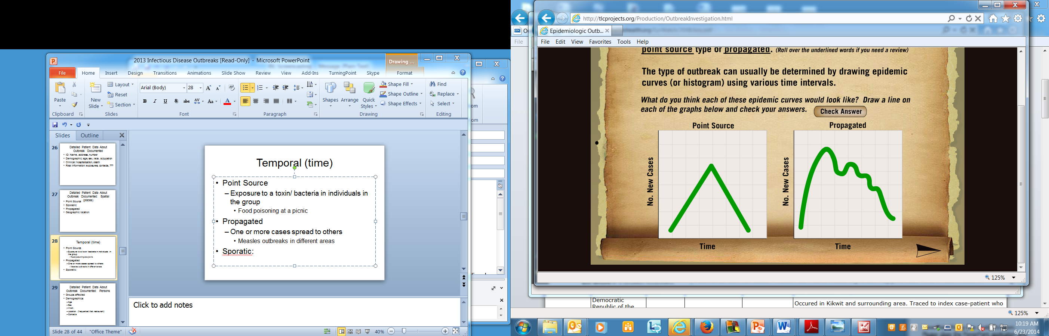
Detailed Patient Data About Outbreak Documented
Temporal (time)
Point Source
  Exposure to a toxin/ bacteria in individuals in the group
    Food poisoning at a picnic
Propagated
  One or more cases spread to others
    Measles outbreaks in different areas
Sporadic: no known
pattern of increase

Slide 32
Steps of an Outbreak Investigation
Prepare for field work
Establish the existence of an outbreak
Verify the diagnosis
Define and identify cases
Describe and orient the data in terms of time, place, and person
Develop hypotheses
Evaluate hypotheses
Refine hypotheses and carry out additional studies
Implement control and prevention measures
Communicate findings

Slide 33
Develop Hypotheses:
Why did this occur now?
Familiarity with the disease process, mode of transmission, incubation, etc
Ebola virus:
  Reason for outbreak occurrence unknown
  Spread through contact
  Instituting Viral Hemorrhagic Fever Isolation Precautions decreases incidence

Slide 34
Develop Hypothesis: Why Did This Happen Now?
Decrease in vaccinations
  Meningococcal outbreaks
Improper food handling
  Salmonella outbreaks
Animal contact
  Avian influenza
  Marburg virus
MDR
  Overuse of antibiotics

Slide 35
Evaluate Hypotheses
Compare facts with hypothesis
  All these cases ate the same food/ at the same place
  All these cases had contact with others who had the same illness
Cohort
  Study all people in a group
Case controlled
  Compare risk exposed vs control group

Slide 36
Steps of an Outbreak Investigation
Prepare for field work
Establish the existence of an outbreak
Verify the diagnosis
Define and identify cases
Describe and orient the data in terms of time, place, and person
Develop hypotheses
Evaluate hypotheses
Refine hypotheses and carry out additional studies
Implement control and prevention measures
Communicate findings

Slide 37
Control and Prevention
Vaccine
Chemoprophylaxis
Isolation
Antibiotics
Hand washing
Food handling
Mosquito breeding prevention
Insect repellent

Slide 38
Steps of an Outbreak Investigation
Prepare for field work
Establish the existence of an outbreak
Verify the diagnosis
Define and identify cases
Describe and orient the data in terms of time, place, and person
Develop hypotheses
Evaluate hypotheses
Refine hypotheses and carry out additional studies
Implement control and prevention measures
Communicate findings

Slide 39
Communicate Findings
Analysis and distribution of public health data via publications, presentation and reports
MMWR (Morbidity and Mortality Weekly Report)
NEWS/ media/ internet

Slide 40
Information Loop of Public Health Surveillance
Public
Reports
Summaries,
Interpretations,
Recommendations
Health Care
Providers
Health
Agencies
Analysis

Slide 41
MMWR publication
Methyl Bromide Release at a Condominium Resort —
U.S. Virgin Islands, March 2015
Prathit A. Kulkarni, MD¹, Mary Anne Duncan, DVM², Michelle T. Watters, MD, PhD³, Leah T. Graziano³, Elena Vaouli, MPH³, Larry F. Cseh, MS², John F. Risher, PhD², Maureen F. Orr, MS², Tai C. Hunte-Ceasar, MD⁴, Esther M. Ellis, PhD⁴

Slide 46
Notes:
Vector-borne diseases in general are especially ecologically sensitive since environmental conditions can have dramatic effects on the vectors, pathogens, and potential hosts involved in transmission. The diversity of environmental factors and contexts associated with vector=borne disease emergence is illustrated here. The association between environment and disease epidemiology is a consequence of vectors and non-human reservoir hosts, having specific habitat requirements. As habitats change, so too does disease epidemiology.

Slide 47
Spectrum of ecological interactions associated with vector-borne disease transmission
Notes:
It is this entire system of interactions involving human and natural constituents and processes, causal relations including driving forces, modulating factors, and effects (including disease emergence) the collectively constitue an ecosystem.
A spectrum of these elements is presentated in this figure. From which the interconnectedness of these diverse interactions is evident.

Slide 48
Conclusion
Surveillance provides information on the health of the community
Public health relies on information from medical care providers and takes prevention-oriented actions based on information received
Surveillance involves taking information in, analyzing and interpreting it, and disseminating it to those who need it

Slide 49
Questions?
Contact Dr. Esther M. Ellis
  esther.ellis@doh.vi.gov
  (340) 718-1311 ext.3841

